Slide 1

Outmoni
Full-Stack Personal Finance Tracker
A modern, monorepo-powered finance app — built to help individuals track, visualize, and take control of their money.
TURBOREPO
NEXT.JS
TYPESCRIPT
MONGODB

Slide 2

The Problem
💸 No Clear Picture
📊 Fragmented Tools
Most people lack a unified view of income, expenses, and spending habits — making informed financial decisions nearly impossible.
Spreadsheets, bank apps, and notebooks don't talk to each other. Data is scattered, inconsistent, and hard to visualize.
🔒 Privacy Concerns
Users are wary of sharing financial data with third-party aggregators. Trust and transparency are non-negotiable.

Slide 3
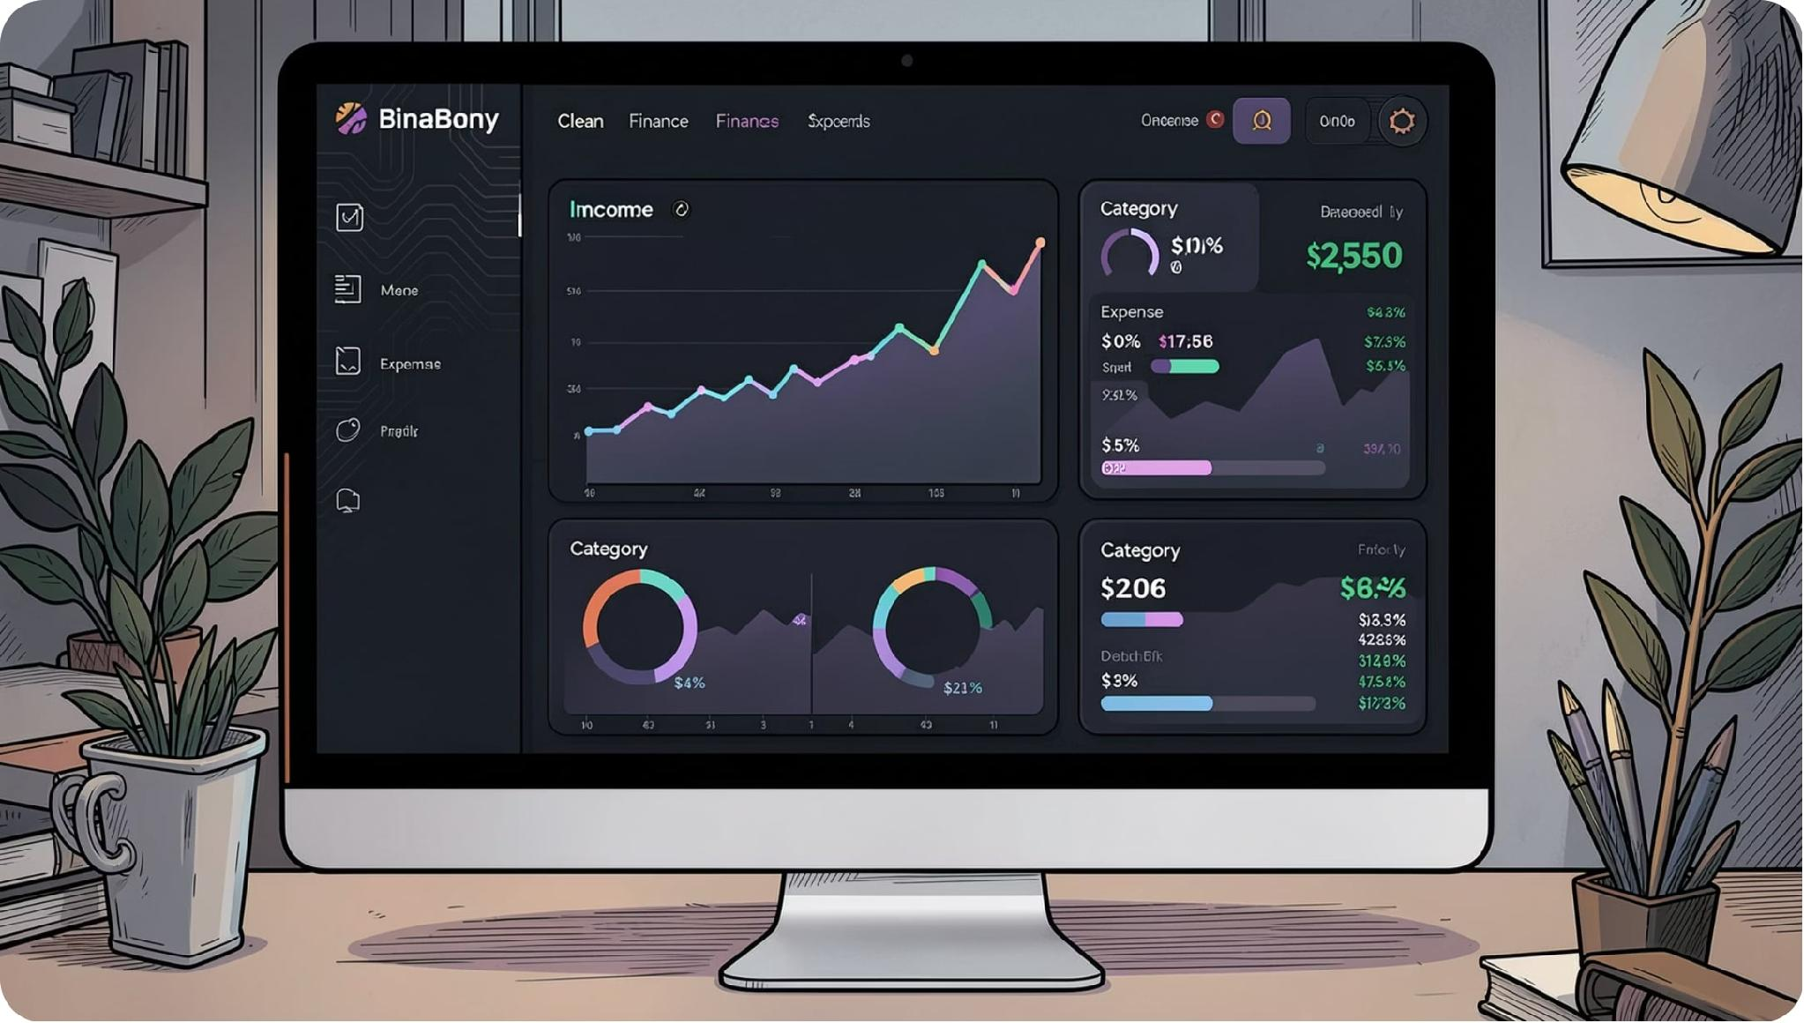




The Solution
Outmoni brings clarity to personal finance.
A self-hosted, full-stack finance tracker that gives users a real-time, visual overview of their financial health — without relying on third-party data aggregators.
Secure login via Google OAuth
CRUD APIs for income & expenses
Responsive dashboard with live charts
Category & date filters for deep insights

Slide 4

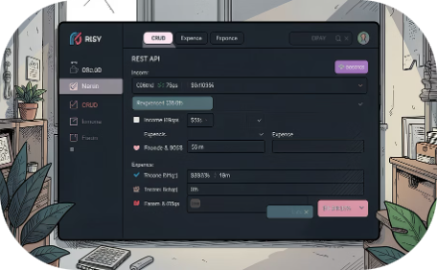
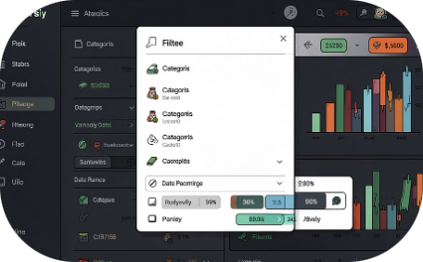

Key Features
Google OAuth Auth
CRUD APIs
Smart Filters
Responsive Dashboard
Secure, seamless authentication powered by Google OAuth 2.0 — no password management required.
Full RESTful APIs for managing income and expense records with validation and error handling.
Filter transactions by category, date range, or type to uncover spending patterns instantly.
Mobile-first, responsive UI with an interactive income vs. expense chart built for every screen size.

Slide 5
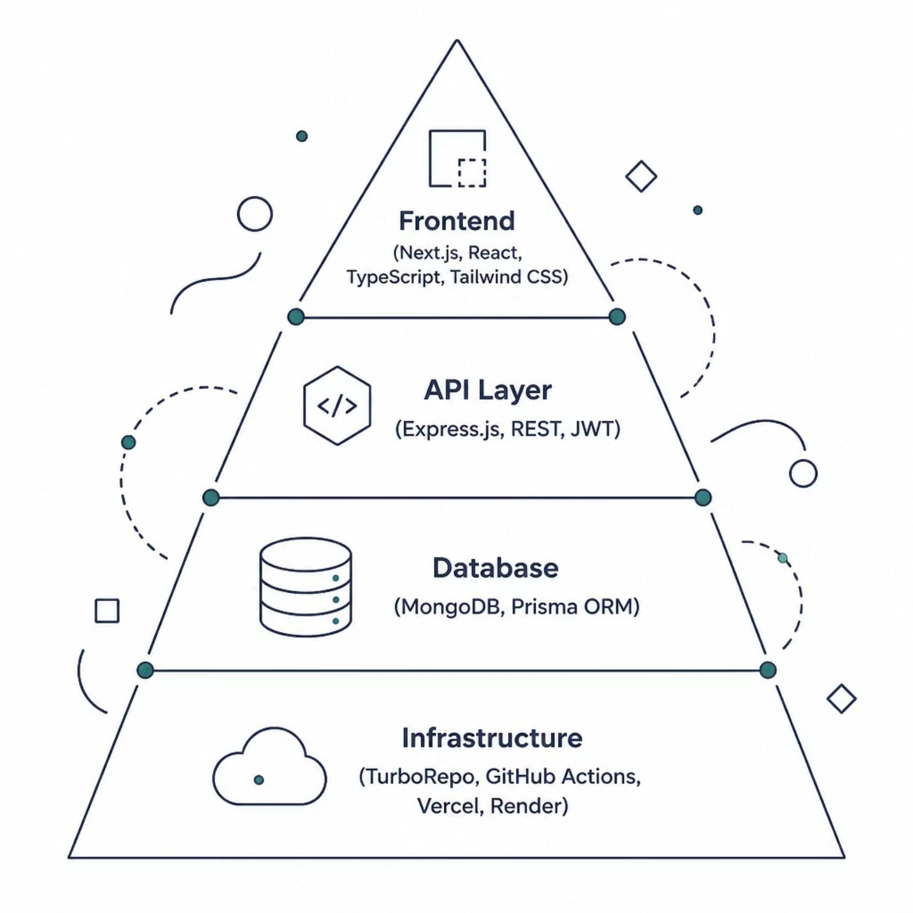




Tech Stack
Outmoni is built with a modern, type-safe stack designed for scalability and developer experience.
Next.js 14
Express.js
React framework with App Router, SSR, and API routes
Lightweight backend server with RESTful API design
TypeScript
MongoDB + Prisma
End-to-end type safety across frontend and backend
Flexible document database with a powerful ORM layer

Slide 6

TurboRepo Monorepo Architecture
Shared Packages
Apps
Tooling
Outmoni uses a TurboRepo monorepo to co-locate the frontend and backend in a single repository — sharing TypeScript configs, Prisma schemas, and UI components while maintaining clean separation of concerns. This setup enables faster local development, consistent linting, and simplified dependency management across both apps.

Slide 7
REST API Flow & CI/CD Pipeline
API Architecture
GitHub Actions CI/CD
Outmoni exposes a clean REST API with dedicated endpoints for authentication, transactions, and analytics. The frontend communicates with the Express backend via typed API calls, with JWT-based session management.
Every push triggers an automated pipeline — linting, type-checking, and testing run on every PR. Merges to main auto-deploy to production.
01
02
Client sends request (Next.js)
JWT validated by Express middleware
03
04
Prisma queries MongoDB
JSON response rendered in UI
🔬 Lint & Type Check
🧪 Run Tests
🚀 Deploy to Vercel + Render

Slide 8

Deployment Architecture
🔵 Frontend — Vercel
🟢 Backend — Render
Next.js app deployed on Vercel with automatic preview deployments per PR, edge caching, and zero-config SSR support.
Express.js API hosted on Render with auto-deploys from GitHub, managed environment variables, and persistent MongoDB connection.
🟡 Database — MongoDB Atlas
Fully managed cloud database with connection pooling, automated backups, and environment-scoped access control.

Slide 9

Key Learnings
Monorepos simplify complexity
TurboRepo made sharing types, configs, and utilities between apps seamless — a pattern I'll carry forward.
TypeScript pays off
End-to-end type safety caught entire classes of bugs before runtime, especially across API boundaries.
CI/CD is non-negotiable
Automated pipelines gave confidence to ship fast. GitHub Actions became a core part of the dev workflow.

Slide 10
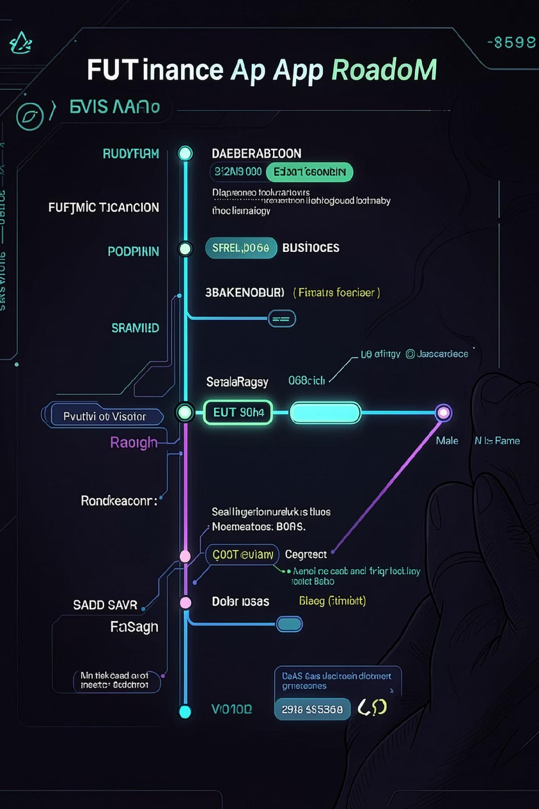

What's Next for Outmoni
1
Budget Alerts
Push and email notifications when spending exceeds category budgets.
2
Bank Sync
Plaid integration for automatic transaction imports from connected bank accounts.
3
Reports & Export
Monthly PDF reports and CSV export for deeper offline analysis.
4
Mobile App
React Native companion app for on-the-go expense tracking.
Outmoni is open source. Check out the repo to explore the code, contribute, or fork it for your own use.

